Slide 1
Lessons Learned: Use of an Intermediary to Assist a Multi-state Consortium of Community Colleges with Employer Engagement
Kate Dunham, Marian Negoita, and Heather Lewis-Charp
November 10, 2015

Slide 2
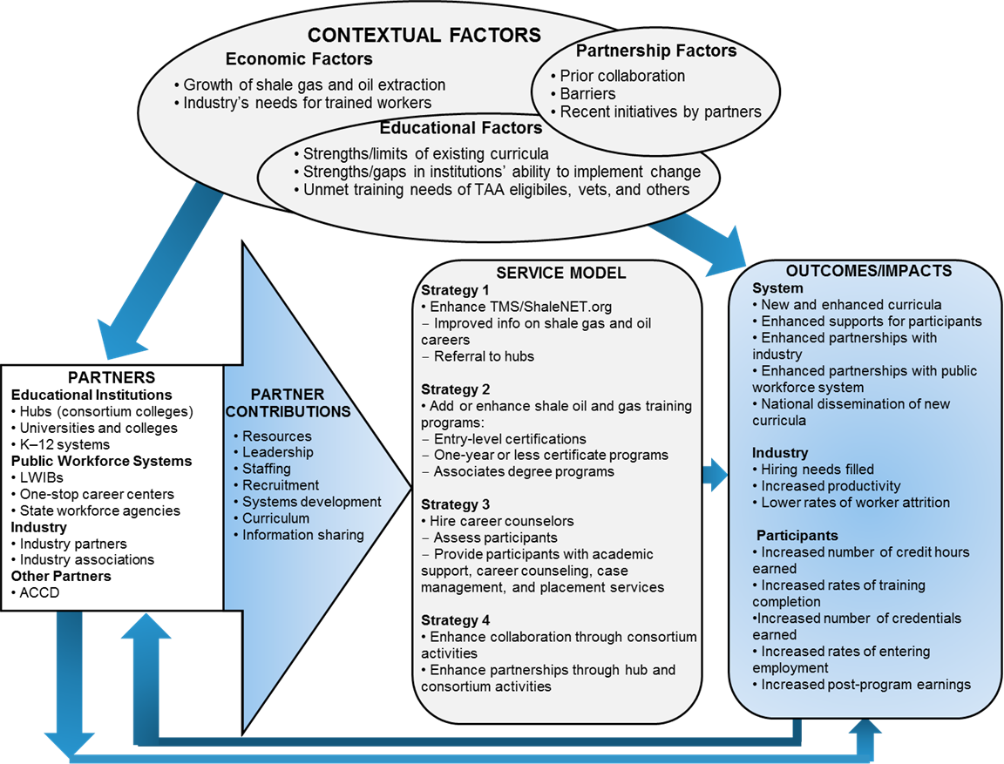
ShaleNET Background

Slide 3
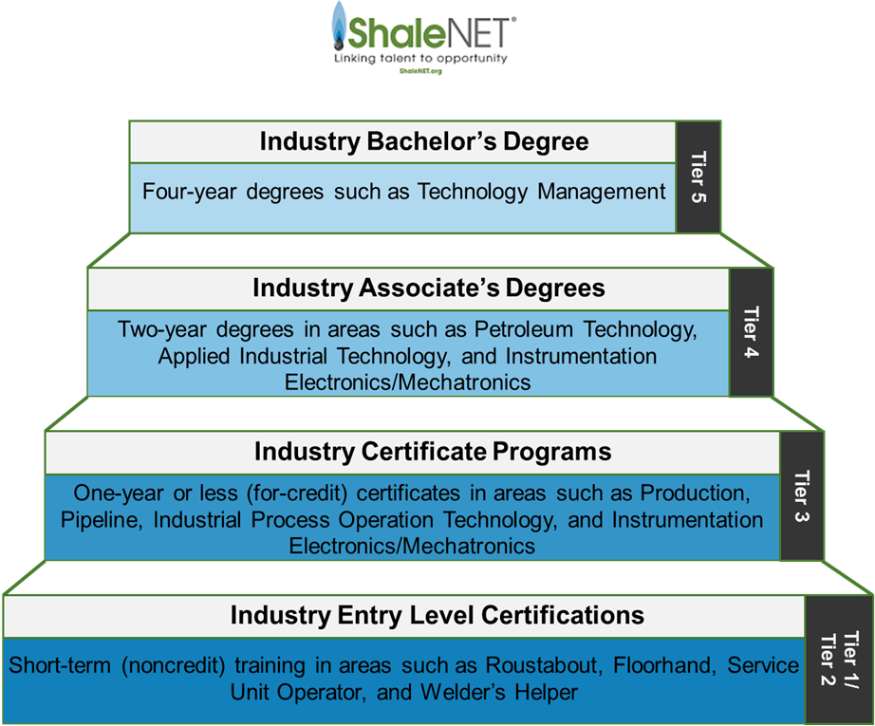
ShaleNET Background

Slide 4
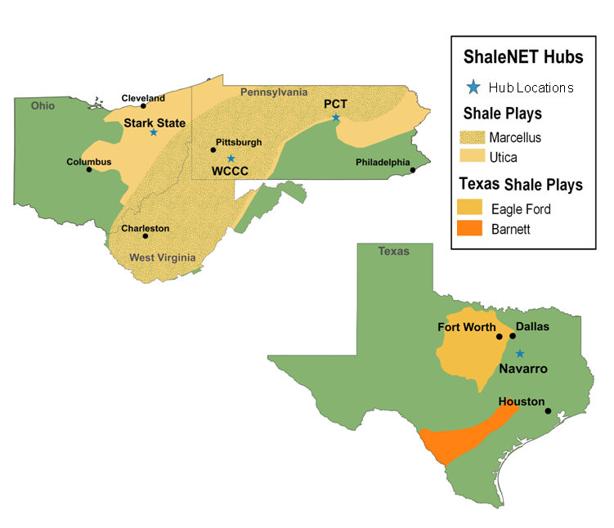
ShaleNET Background

Slide 5
ShaleNET Evaluation Overview
Multi-method Design
Implementation Study
Impact Study
Quasi-experimental design
Three rounds of site visits
Employer & WIB surveys
Observations and document reviews
Workforce and UI data from PA
Academic data from Texas college and UI data from TX

Slide 6
ShaleNET Evaluation Overview
How Employer Engagement is Assessed:
Industry contributions (in-kind and funding)
MSC 2014 membership survey results
Semi-structured phone interviews with ACCD staff & 20 oil and gas industry reps.
Observations of ShaleNET hub partner meetings and industry advisory groups

Slide 7
ShaleNET Industry Engagement
Dual Approach
ACCD Outreach
Cross-consortium
Individual Hub Outreach
Shale Oil and Gas Industry
Small, local companies Local staff of large companies
Large company regional HQ staff
Notes:
Need to do both

Slide 8
Hub Outreach
Phone, email, in-person
Lab tours
Advisory meetings
Industry trade shows, conferences

Slide 9
ACCD Outreach
ShaleNET Leadership
General Marketing to Industry
Relationship Building with Industry Leaders
ACCD
(Intermediary)
Shale Oil and Gas Industry
Large company Regional HQ Staff

Slide 10
Results of Dual Approach: Gas and Oil Industry Support
Gas and oil industry partners provided extensive and various types of support valued at approximately $770,000
“Their [ShaleNET] programs really meet our needs in terms of the coursework and the hands-on training that the college provides.”
— Industry partner, Stark State

Slide 11
Results of Dual Approach: Gas and Oil Industry Support
Approximately $232,000 in scholarship funds
In-kind donations
Equipment conservatively valued at $282,000
Staff members’ time to:
Assist with finding or serving as instructors
Review and provide feedback on program curricula
Provide work-based learning opportunities such as internships and facility tours.

Slide 12
Results of Dual Approach: Gas and Oil Industry Support
ShaleNET completers
Employers expressed satisfaction with ShaleNET completers
Employers appreciated career counselors as single point of contact--making it very “easy” to hire
“Overall, I love working with [ShaleNET]. The career counselor always sends me quality students that are willing to work hard. The ease of working with her makes [ShaleNET] a great asset to me. They are very responsive, which is what I love.” — Industry partner, WCCC
Notes:
This is based on qualitative interviews; We are in the process of carrying out a survey or employers who have hired to collect better data on this.

Slide 13
Lessons Learned
Benefits
Builds on existing industry connections
For large companies; need to connect in both field & boardroom
Notes:
This is based on qualitative interviews; We are in the process of carrying out a survey or employers who have hired to collect better data on this.

Slide 14
Lessons Learned
Challenges
Takes lots of time; not easy to make changes
Consortium & intermediary geography need to align
Notes:
This is based on qualitative interviews; We are in the process of carrying out a survey or employers who have hired to collect better data on this.

Slide 15
Questions?
Authors
Kate Dunham: Kate_Dunham@spra.com, 510-788-2475
Marian Negoita: Marian_Negoita@spra.com, 510-788-2477
Heather Lewis-Charp: Heather@spra.com, 510-788-2471

