Slide 1
Keeping Up With Demand: Measuring Labor Market Alignment in TAACCCT Programs
Michelle Van Noy and Jennifer Cleary
TCI Research Symposium: Evidence of What Works in TAACCCT
Chicago, IL
November 10, 2015

Slide 2
Introduction
Increasingly, policy initiatives, including TAACCCT, focus on having colleges align their programs with the needs of the labor market to improve outcomes for employers and students.
However, labor market alignment (LMA) in higher education is a poorly understood concept.
Cleary &Van Noy (2014) performed an extensive literature review to develop a framework for understanding LMA.
This paper draws on this framework and, using it as a research lens, applies it to the synthetic analysis of two ongoing TAACCCT process evaluations.

Slide 3
Goals of this paper
To provide an introduction to the Cleary/Van Noy LMA framework
To demonstrate the potential application of the LMA framework to process evaluations in the community college & TAACCCT contexts.
To provide TAACCCT and other community college researchers with tools to examine a wider range of activities and outcomes to understand the impact of LMA activities.

Slide 4
Seems like a simple feat of engineering…..yet, alignment is not well understood
Need for information on “what works” and how to improve outcomes and preserve core missions of higher education.
The goals of alignment, and how they reflect stakeholder needs
The range of approaches to alignment
Settings and systems where alignment strategies are implemented
Link between alignment approaches and outcomes
How to balance with liberal education mission of higher education

Slide 5
Prior Research
Characteristics of labor market responsive community colleges, Harmon & MacAllum (2003) and MacAllum & Yoder, 2004
Identification of internal and external factors related to community college approaches to alignment, Adams, Edmonson & Slate (2013)
Broad framework for labor market alignment across institution types and levels, focused on LMA practices and outcomes, Cleary &Van Noy (2014)

Slide 6
What is Higher Education Labor Market Alignment?
Activities and outcomes to ensure that higher education institutions graduate the correct numbers of graduates with the necessary skills for the job market in a way that supports students’ career goals and is consistent with institutional mission and labor market conditions.
Job Vacancy Alignment “Getting the numbers right”
Skills Alignment
Ensuring competency

Slide 7
Alignment Can Include Curricular and Co-Curricular Areas
 | Job Vacancy Alignment | Skills Alignment
Curricular
Program selection and enrollment management | X
Program content and curriculum development |  | X
Instructional & assessment strategies |  | X
Co-Curricular
Work-based learning activities |  | X
Student advisement and support services | X | X

Slide 8
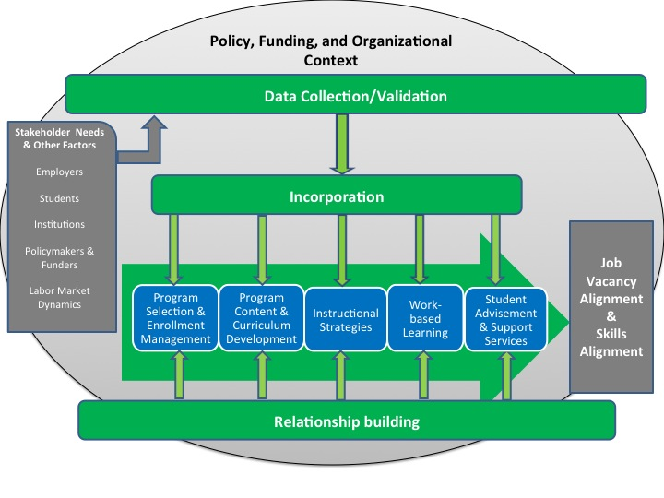

Slide 9
Studying LMA Processes at work in TAAACCCT
To understand the implementation of LMA, we focus on the three main processes of LMA:
Research Questions
What approaches to the LMA processes of data collection /validation, incorporation, and relationship building did case study colleges engage in?
To what extent were the case study colleges successful in the implementation of these LMA processes?
What challenges did the case study colleges encounter with these LMA processes?
Data collection/validation,
Incorporation into curricular and co-curricular activities
Relationship-building

Slide 10
Cases and Methods
Case Study Evaluations:
Case #1 – reforms to multiple workforce programs in a range of fields
Case #2 – reforms to programs in manufacturing and utilities
Data Collection:
Multiple site visits including structured interviews of program staff and key stakeholders
Document reviews of policies, procedures
Observations of program activities
Focus groups with students

Slide 11
Findings: Data Collection
Use of labor market data
to determine focus for TAACCCT programs
to ensure programs met students wage needs
Use of multiple existing data sources
Gathered direct information on skill demand using substantially different approaches
DACUM vs. one-hour focus groups
Other information sources informed programs including industry credentials and industry-based instructors

Slide 12
LMA Approaches: Data Collection
Data Collection
Case #1 | Case #2
Used multiple sources of existing data | Used multiple sources of existing data
Conducted in-depth DACUM and employer panels | Conducted one-hour focus groups with employers

Slide 13
Findings: Incorporation-curricular
Demand-driven program selection
Established basic admissions criteria and enrollment targets
Involvement of employer in admissions and instruction
Guided instructors to emphasize some topics more than others
Efficiently translating detailed data into curriculum was a challenge

Slide 14
LMA Approaches: Incorporation-Curricular
Incorporation - Curricular
Case #1 | Case #2
Program selection is demand driven | Program selection is demand driven
DACUM/employer panel input guided instructional focus but challenging to translate into curriculum | Used curriculum from national and regional employer-recognized certifications
DACUM/employer panel input informed admissions standards | Employers involved in admissions interview

Slide 15
Findings: Incorporation-co-curricular
Job shadowing to learn about the industry
Employer hosts needed guidance for job shadowing
Intensive on the job experience requirement - varied
Early involvement of employers in program led to job offers
Setting expectations among students was a challenge
Jobs at wages lower than standard
Students’ financial needs and prior work experience
Some employers associated the program were not hiring or had inappropriate working conditions

Slide 16
LMA Approaches: Incorporation-Co-curricular
Incorporation – Co-curricular
Case #1 | Case #2
Job shadowing integrated in program |  | Job shadowing integrated in program
Intensive practicum required |  | No practicum or internship
Job placement done by program staff, sometimes via job shadowing and practicum experiences |  | Job placement done by program staff, sometimes via initial admissions interview
Setting student expectations about jobs was a challenge |  | Setting student expectations about jobs was a challenge

Slide 17
Findings: Relationship Building
Intensive employer involvement in the data collection and/or incorporation process was also important for relationship building
Multiple staff worked together to make contacts with local employers and gradually build relationships by engaging employers in a range of activities.
The approach to building employer relationships vary was centralized rather than disbursed amongst instructors
With job placement some instructors take an active role in placement

Slide 18
LMA Approaches: Relationship Building
Relationship Building
Case #1 | Case #2
DACUM and employer panels led to relationship building | Early involvement of employers in admissions and other activities led to relationship building
Multiple centralized staff conducted outreach | Centralized staff and local college staff conducted outreach

Slide 19
Conclusions
Preliminary attempt to apply LMA framework to TAACCCT evaluation synthesizes lessons across projects
Findings demonstrate that this framework can offer a common language to make sense of commonalities and differences in approaches to LMA
Further analysis across other TAACCCT projects may offer deeper insights into LMA

Slide 20
Contact Information
Michelle Van Noy
mvannoy@rutgers.edu
848-445-4734
Jennifer Cleary
jcleary@docs.rutgers.edu
848-445-9291

