Slide 1
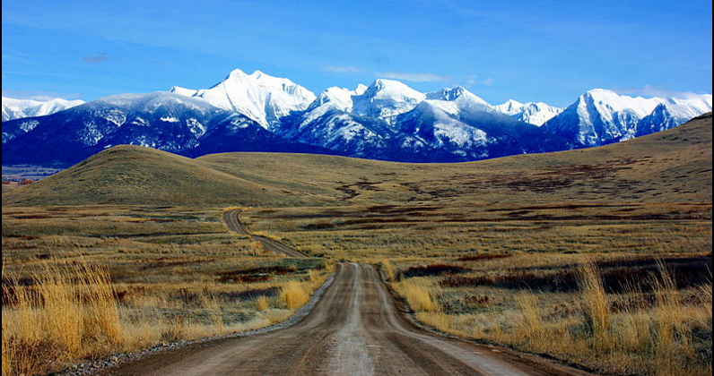
Apprenticeship in Montana
New Directions in Policy and Practice
Sandra Staklis and Kevin Jordan
TCI Research Symposium: Evidence of What Works for TAACCCT
Notes:
The Mission Mountains in Montana
Photo credit:

Slide 2
RevUp Montana
13 two-year colleges throughout
Montana
Manufacturing and energy
Stackable certificates and industry-recognized
credentials
Online course offerings
Apprenticeship (with Montana HealthCARE)
Developmental math
Coaching
Notes:
RevUp is funded by a TAACCCT III grant.
Project focus is firmly on instituting certificates of technical skills after each program semester, and offering industry recognized credentials.
There are other areas of activity, and apprenticeship is on of these.
The project seeks to expand opportunities for students to pursue registered apprenticeships in manufacturing and, to a lesser extent, energy

Slide 3
Apprenticeship: One day in the media
Apprenticeships offer debt-free training
San Francisco Chronicle
Oregon a national leader in recruiting women
apprentices but challenges remain
The Oregonian
Apprenticeship first step
on ladder to middle class
Wichita Eagle
How Apprenticeship
Will Save the
U.S. Economy
Forbes
Notes:
Admittedly, this day (November 5) was during the U.S.’s first ever National Apprenticeship Week, which was last week.
Contrast between heightened interest in apprenticeship – and the issues that apprenticeship is seen as a means for addressing

Slide 4
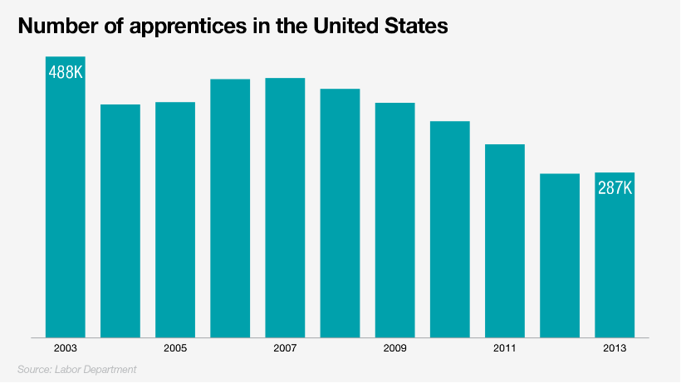
vs. current status of apprenticeship in the U.S.
Notes:
All active apprenticeships underway in the U.S.
The numbers have since increased to an estimated 430K in the third quarter of 2015.
Like employment, apprenticeship numbers declined when the economy is weak, and especially construction.
In contrast, 540,000 new apprentices signed up in Germany in 2011 alone.

Slide 5
National Context
Traditional Apprenticeship
Oversight provided by the Department of Labor or state agencies
Majority of apprentices in construction trades and manufacturing
Time based
Newer Trends
American Apprenticeship Grants
Registered Apprenticeship College Consortium
New fields: healthcare and information technology
Competency-based models
Notes:
Oversight is provided by the federal Office of Apprenticeship for 25 states; others have their own agencies.
Majority are in construction trades (e.g., electricians or plumbers). American apprenticeship grants focus on establishing new apprenticeships in IT and healthcare fields as well as scaling up programs in the trades.
Most apprenticeships require 2,000 hours of OJT and a minimum 144 hours of related instruction; Newer models allow for credit for prior learning from industry or military experience or college coursework.
Over 200 colleges joined the Registered Apprenticeship College Consortium (RACC), pledging to give college credit for students who complete apprenticeship programs

Slide 6
Requirements of Registered Apprenticeship
Employer involvement
Structured on the job training
Related technical instruction
Paid work experience with incremental wage increases
Alignment with industry-recognized credential
Notes:
Apprenticeships are offered by sponsors: individual employers, employer associations, or labor/management organizations.
Sponsors provide paid OJT and workplace mentors and contribute to curriculum designed to teach technical content.
This instruction may be provided at a partnering postsecondary institution, training center, sponsor-owned or operated facility, or trade school (Lerman, Eyster, and Chambers 2009).

Slide 7
Benefits
Earn while you learn
Low cost to the public
Higher earnings
Workforce development
Notes:
Earn while you learn: Apprentices are paid while receiving on-the-job training.
Low cost to public: Employers and unions cover most of the costs. For example, construction unions and contractors report investing more than $1 billion in apprentice and journey-level training, tens of millions of dollars more in construction training plants and equipment, and $10 billion in apprentice wages and benefits annually (Olinsky & Ayres, 2013).
Higher earnings: After completing an apprenticeships, individuals earn more than comparable job-seekers. Reed et al., found that an apprentice, earns, on average, 1.4 times more than a similar worker six years after entering a program.
Workforce development: Apprenticeships provide employers with highly-qualified workers. Employers report lower levels of attrition and workplace safety incidents and a better culture fit. Lerman, Eyster, and Chambers 2009

Slide 8
Issues
Underutilized
Public perception
Portability
Decreasing union numbers
Weak or neglected instruction
Attrition
Notes:
Underutilized: There are very few apprenticeship programs in the U.S. compared to other countries, and apprenticeship participants are predominantly 25 or older. 1 in 5 under 25 with average age of 30.
Public perception: Many Americans know little about apprenticeship and employers tend to associate apprenticeship with unionization
Portability: Focused training may make it difficult for individuals to change careers or sectors
Decreasing union numbers: As union membership declines, there are fewer partners, possibly leading to a shift in costs to employers and the public sector.
Instruction: Apprentices often have difficulty completing required coursework while working.
Attrition: Many apprenticeship programs have high dropout rates of 50 percent or more

Slide 9
Suggestions from the Field
Recruitment
Marketing
Tax credits and subsidies
Financial aid
Increase diversity
Community college involvement
Notes:
Recruit high school students and unemployed recent graduates for apprenticeships through pre-apprenticeship and other programs
Improve marketing and awareness of apprenticeship programs
Provide tax credits and subsidies for businesses to offer apprenticeships
Allow the use of postsecondary financial aid, such as Pell Grants, and other financial support for apprenticeship programs
Identify and support apprenticeships that attract women and minorities
Expand connections among apprenticeship programs and community colleges

Slide 10
Apprenticeship in Montana
Registration by state agency
949 active registered apprenticeships in 2014
Construction fields dominate
50/50 union/non-union
Notes:
If calculated as a percentage of the population for 2015, Montana is right in the middle of states at 23.

Slide 11
Case Study Research Questions
What needs do stakeholders feel that apprenticeship can meet, and why is it regarded as the best approach for filling those needs?
In what ways do existing apprenticeship opportunities need to change to meet those needs?
What strategies have been tried, and how successful have the efforts to introduce new opportunities been?

Slide 12
Data Collection
Interviews
State agency representatives
College administrators
Employers
Other stakeholders (unions, economic development organizations)
Site visits
Employer and student survey
Notes:
12 interviews to date, about half from higher education administration and half state agency representatives
We have also collected information on apprenticeship during site visits, where we asked faculty, students, administrators, and employers about what apprenticeships are and whether they have any interest in participating
Finally, we currently have an employer survey out to about 150 employers in the state that includes questions on apprenticeship, and there will be a student survey in the spring that will also include apprenticeship itemss

Slide 13
Need for Apprenticeship
Workforce development
Skill gap, lacked of skilled workers
Young people leaving Montana
Ease faculty shortages
Access to new funding sources for education
Control college costs
Notes:
Attract workers, and especially young workers, to new fields, areas with severe labor force shortages
High school graduates with low skill levels leave the state for higher paid jobs out of state, especially in the Bakken oil fields and to a lesser extent in MT
At the same time, the growth of the manufacturing is slowed by the inability of firms to find workers with the skills they need

Slide 14
Need for Change in Apprenticeship
Improved instruction and outcomes
Higher rates of college completion
Workforce flexibility
Notes:
-First most important: Instruction weakest part of apprenticeship; about a 50% percent drop out rate
-More highly skilled workforce
-Criticism of apprenticeship has been that it is too specialized

Slide 15
RevUp: Existing Apprenticeships
RevUp grads: Streamlined application process with reduced on-the-job training and instructional requirements
Apprenticeship certificate holders: Award credit toward degrees
Notes:
Three strategies:
The first strategy is to provide an opportunity for graduates of the RevUp programs to enter apprenticeship with reduced requirements.
Currently, one college in the state does this in construction fields; hoping to expand to other colleges and also new fields
Starting by doing an agreement between the unions and the colleges; still pending
Next, they would like to offer those who have an apprenticeship to receive credit for prior learning and be able to earn a AAS degree in a field related to their apprenticeship.
Credit for prior learning has been pretty restricted in MT. Recently (in September) some limits of the number of credits that can be awarded were changed, but still at instructor discretion. Would like to have an agreement in place that would say apprenticeship certificate holders are eligible for X amount of credits in an AAS degree program, and that this agreement would be valid statewide, wherever the program is offered.

Slide 16
RevUp: New Apprenticeships
Accelerated program that offers:
Competency-based instruction
Integrated college coursework and on-the-job training
Tuition covered by employer and/or financial aid
Offers an AAS and apprenticeship certificate
Notes:
For all others they wanted to establish a different kind of apprenticeship with these features; some promising programs in the state, but not really any consensus that this model is the right one, or that this model is feasible right now. Three new programs emerging across the state: construction, manufacturing, and sheet metal
Nascent programs are still pretty much hours based.
The level of integration of coursework and OJT varies: for construction, students attend school in the off season; sheet metal, they do coursework first, then OJT. The manufacturing program is with five employers and has the most potential to truly integrate coursework and OJT, but has run into difficulties in that the employers don’t want to release the apprentices for class during working hours, and faculty are unwilling to teach in the evening or on weekends
Financial aid eligible since students are typically attending school FT, but beyond wages, employers not covering education costs
For the AAS, need to complete all of the classes that they would if they weren’t an apprentice
Do offer an AAS and apprenticeship certificate, but not particularly accelarated.

Slide 17
Apprenticeship in RevUp: Approach
Expand agreements between existing apprenticeship programs and college
Establish new programs
Outreach through workforce navigators
Recruit employers to work with state apprenticeship office
Develop a template/set of guidelines
Replicate initial models
Notes:
So how did RevUp approach their work in apprenticeship?
Mentioned RevUp’s work to connect union and college programs.
But for establishing new apprenticeship programs using a different model than has been used in the past, had a college level approach that depended heavily on workforce navigators, whose role is to connect RevUp programs with employers for their input, for recruiting students, and also for student job placement

Slide 18
Challenges
Misconceptions: employers and colleges
Accreditation requirements
Employer interest/commitment
Need to adapt college programs
Notes:
College staff: Why needed? Why should colleges be involved? Confusion with paid-internships; co-ops. Employers: Concerns about union involvement
Accrediting agencies place restrictions on the number of credits that can be awarded for prior learning, or for experiential learning not taught by faculty
Low employer interest, either from competing demands, concerns about burden and costs, and also, own training programs
Inflexibility on the part of colleges regarding the way programs are offered – course scheduling

Slide 19
RevUp and Montana HealthCARE
Establishing model programs
State-level liaison between the Department of Industry and Labor and the colleges
Three regional specialists dedicated to developing apprenticeships in healthcare
Outreach and marketing campaign
Notes:
In response to these challenges, RevUp has changed how it is addressing apprenticeship, and also the new HealthCARE TAACCCT IV program stated that their approach is based on lessons learned from RevUp

Slide 20
Case Study: New Questions
In what ways might apprenticeship efforts need to be scaled to a small state with many small manufacturers?
How does apprenticeship connect to other education and workforce initiatives?
What about women and tribal colleges?
Notes:
Employer demand; lack of interest
Connection with other work
4 percent of apprenticeship participants in MT now are women.

